Slide 1
MODULE IV

Slide 2
Module IV
Syllabus: -
Virtual Destructors – Virtual Base Classes - Template- class templates and function templates- Creating and using templates – Namespaces-Dynamic Objects - Dynamic object allocation - Inline functions. Exception Handling-basics of exception handling-exception handling mechanism- Throwing and Catching Mechanism-Rethrowing and Specifying exceptions.

Slide 3
Constructors
Constructors are special class functions which performs initialization of every object.
The Compiler calls the Constructor whenever an object is created.
Constructors initialize values to object members after storage is allocated to the object.

Slide 4
Destructors
Destructor is a special class function which destroys the object as soon as the scope of object ends.
The destructor is called automatically by the compiler when the object goes out of scope.
The syntax for destructor is same as that for the constructor, the class name is used for the name of destructor, with a tilde ~ sign as prefix to it.

Slide 5
Virtual Destructors
Constructors cannot be made virtual. (Refer Module I)
But destructors in the Base class can be Virtual. Destructors of the Base class must be made virtual for proper destruction of the object when the program exits.

Slide 6
Base class destructor without “virtual”
#include <iostream>
using namespace std;
class Base
{
public:
Base()
{
cout << "Base Constructor\t";
}
~Base()
{
cout << "Base Destructor\t\n"; }
};
class Derived: public Base
{
public:
Derived()
{
cout << "Derived Constructor\t\n";
}
~Derived() { cout<< "Derived Destructor\n"; }
};
int main()
{
Base* b = new Derived; //Upcasting
delete b;
}

Slide 7
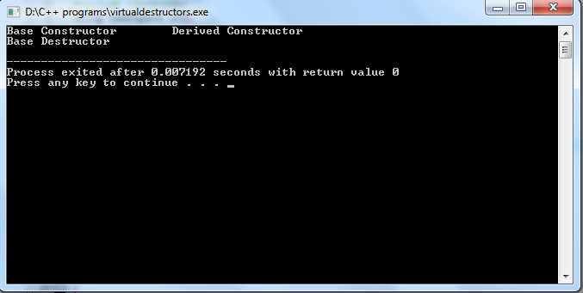
Output ..
In the above example, delete b will only call the Base class destructor. It is undesirable because, then the object of Derived class remains un-destructed, since its destructor is never called. This results in memory leak.

Slide 8
Virtual Destructors
#include <iostream>
using namespace std;
class Base
{
public:
Base()
{
cout << "Base Constructor\t";
}
virtual ~Base() {
cout << "Base Destructor\t\n";
}
};
class Derived: public Base
{
public:
Derived()
{
cout << "Derived Constructor\t\n";
}
~Derived() { cout<< "Derived Destructor\n"; }
};
int main()
{
Base* b = new Derived; //Upcasting
delete b;
}

Slide 9
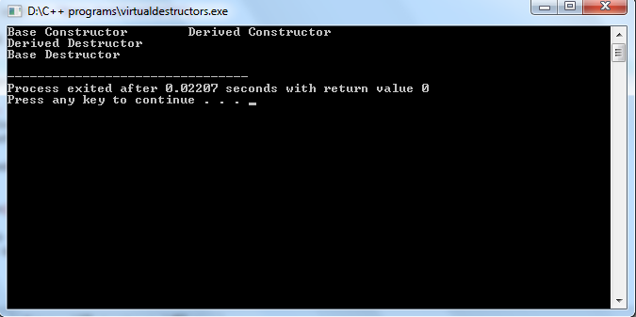
When we have Virtual destructor inside the base class, then first Derived class's
destructor is called and then Base class's destructor is called,
which is the desired behavior.

Slide 10
Templates
A template defines a family of data types.
Templates are the foundation of generic programming, which involves writing code in a way that is independent of any particular type.
A template is a blueprint or formula for creating a generic class or a function.
When an object of a specific type is to be used, the template definition is substituted with the required data type.
Since a template is defined with a parameter that would be replaced by a specified data type at the time of actual use of the class or function, templates are sometimes called parameterized classes or functions.

Slide 11
Templates (Contd..)
The use of Templates helps us to define generic classes and functions thus provides support for generic programming.
A class template for an array helps us to create array of int or float as per need.
The Template defined for the function mul() enables us to multiply int, float and double type values.

Slide 12
Class Template Definition
template <class Typ>
This prefix tells the compiler that we are going to declare a template and use Typ as the type name in the declaration.
Now, Typ may be substituted by any data type including any user defined data types.
template<class T1>
class classname
{
……..
……
};

Slide 13
A class template by itself is not a type, or an object, or any other entity. No code is generated from a source file that contains only template definitions. In order for any code to appear, a template must be instantiated: the template arguments must be provided so that the compiler can generate an actual class (or function, from a function template).

Slide 14
An example : Stack..
#define MAX 10
template <class T> // Using Templates so that any type of data can be given.
class stack
{
protected:
T arr[MAX];
public: T item,r;
int top;
stack()
{
for(int i=0;i<MAX;i++)
arr[i]=0;
top=-1;
}
void push(T a)
{
top++;
if(top<MAX)
{ arr[top]=a;
}
else
{ cout<<" stack is full";
top--;
} }
T pop()
{
if(top==-1)
{
cout<<"stack empty";
return 0;
}
else
{
T data=arr[top];
top--;
return data;
} } };
int main()
{
stack <int>a;
int opt=1;
cout<<" enter the element to be entered in to the stack\n";
cin>>a.item;
a.push(a.item);
cout<<a.pop();
}

Slide 15
Advantage..
Stack <int>a; -- Gives a stack with integers as data members
Stack <float>a; -- Gives a stack with floating point numbers as data members
Stack <char>a; Gives a stack with characters as data members.
.. also, user defined data types can be passed as parameters.
This process of creating a specific class from a class template is called instantiation. The compiler will perform error analysis only when an instantiation takes place.

Slide 16
Class Templates with multiple arguments
More than one generic data type can be created in a class.
They can be specified as a comma separated list in the template specification.
template<class T1, class T2, … >
class classname
{
……..
……
};

Slide 17
Example program
#include<iostream>
using namespace std;
template < class T1 , class T2>
class Test
{
T1 a;
T2 b;
public: Test(T1 x, T2 y)
{
a =x;
b = y;
}
void show()
{
cout<<a<<" and " <<b<<"\n";
}};
int main()
{
Test <float,int> test1(1.23, 100);
Test<int,char> test2 (100,'w');
test1.show();
test2.show();
return 0;
}

Slide 18
Sample question
Write a class template to represent a generic array. Perform the following tasks:
a. To create the array.
b. To modify the value of a given element.
c. To multiply by a scalar value.

Slide 19
Function Templates
Like class templates , function templates can be used to create a family of functions with different argument types.
The general format is ,
template <class T>
returntype functionname (arguments of type T)
{
…………….
// Body of the function
// with type T
………..
…………..
}

Slide 20
Example 1:- program to add
#include <iostream>
using namespace std;
template <class T>
T add(T a, T b)
{
T c ;
c= a+b;
return c;
}
int main()
{
cout<<"sum of integer 2 n 3 is \t:"<<add(2,3);
cout<<"m of floats 5.5 n 6.6. is \t"<<add(5.5,6.6);
}

Slide 21
Eg 2 ( Swapping )
template <typename T>
void Swap(T &n1, T &n2)
{
T temp;
temp = n1;
n1 = n2;
n2 = temp;
}
int main()
{
int i1=1, i2=2;
float f1=1.1, f2=2.2;
char c1='a', c2='b';
cout<<"Before passing data to function template.\n";
cout<<"i1 = "<<i1<<"\ni2="<<i2;
cout<<"\nf1 = "<<f1<<"\nf2="<<f2;
cout<<"\nc1 = "<<c1<<"\nc2="<<c2;
Swap(i1, i2);
Swap(f1, f2);
Swap(c1, c2);
cout<<"\n\nAfter passing data to function template.\n";
cout<<"i1 = "<<i1<<"\ni2="<<i2;
cout<<"\nf1 = "<<f1<<"\nf2="<<f2;
cout<<"\nc1 = "<<c1<<"\nc2="<<c2;
return 0;
}

Slide 22
Eg: 3 ( Sorting )
#include<iostream>
using namespace std;
template<class bubT>
void bubblesort(bubT a[], int n)
{
int i, j;
for(i=0;i<n-1;i++)
{
for(j=i+1;j<n;j++)
{
if(a[i]>a[j])
{
bubT element;
element = a[i];
a[i] = a[j];
a[j] = element;
} } } }
main()
{
int a[6]={1,2,3,4,4,3};
char b[4]={'s','b','d','e'};
bubblesort(a,6);
cout<<"\nSorted Order Integers: ";
for(int i=0;i<6;i++)
cout<<a[i]<<"\t";
bubblesort(b,4);
cout<<"\nSorted Order Characters: ";
for(int j=0;j<4;j++)
cout<<b[j]<<"\t";
return 0;
}

Slide 23
Function templates with multiple parameters
Like class templates , we can add more than one generic data type in the template statement using comma separated list.
template <class T1,class T2, …. >
return type functionname(arguments of T1, T2, .. )
{
…
…..
( Body of the function)
}

Slide 24
#include <iostream>
using namespace std;
template<class T1,class T2>
void display (T1 x , T2 y)
{
cout<<x<<" "<<y<<"\n";
}
int main()
{
display(1999 , " ABC");
display(12.34 , 1200);
return 0;
}

Slide 25
Overloading of template functions
A template function may be overloaded with either template functions or ordinary function of its name.
Overloading resolution is accomplished as follows,
Call an ordinary function that has an exact match.
Call a template function that could be created with an exact match.
Try normal overloading resolution to find a match (Refer mod 3).
An error is generated if no match is found.

Slide 26
Eg: - Overloading
#include <iostream>
using namespace std;
template<class T1>
void display (T1 x )
{ cout<<"template display "<<x<<"\n";
}
void display (int x )
{ cout<<"explicit display "<<x<<"\n";
}
int main()
{
display(100);
display(12.34 );
display('C');
return 0;
}

Slide 27
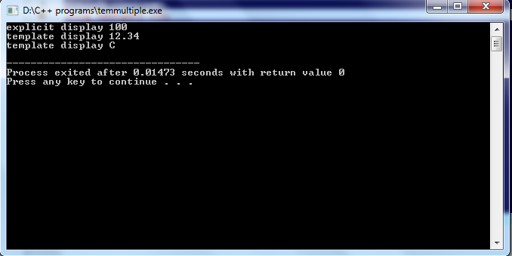

Slide 28
Dynamic Initialization of objects:
Class objects can be initialized dynamically.
i.e , initializing the objects by passing the values to the constructor from the user input or other means.
This form of initializing an object is known dynamic initialization.
Advantage: -
We can provide various initialization formats , using overloaded constructors
This provides the flexibility of using different format of data at runtime depending on the situation.

Slide 29
Eg:- A bank Account
class Fixed_deposit
{ long int P_amount; //Principal amount
int years; //Period of investment
float Rate; //Interest rate
float R_value; //Return value of amont
public:
Fixed_deposit ( ) { }
Fixed_deposit (long int p, int y, float r = 0.12);
Fixed_deposit (long int p, int y, int r);
void display (void);
};
Fixed_deposit :: Fixed_deposit (long int p, int y, float r)
{
P_amount = p;
years = y; Rate = r;
R_value = P_amount;
for (int i = 1; i <= y; i++)
R_value = R_value * (1.0 + r);
} ;
Fixed_deposit :: Fixed_deposit (
long int p, int y, int r)
{
P_amount = p;
years = y;
Rate = r;
R_value = P_amount;
for (int I = 1; I <= y; I++)
R_value = R_value * (1.0 + float ( r ) /100);
}
void Fixed_deposit :: display (void)
{
cout<< "\n"
<< "Principal Amount = " <<P_amount << "\n"
<< "Return Vale = " << R_value << "\n" ;
}

Slide 30
.. Continued..
main()
{
Fixed_deposit FD1, FD2, FD3 ; //deposits created
long int p; //principal amount
int y; //investment period, years
float r;
int R ;//interest rate, percent form
cout << "Enter amount period, interest rate (in percent)" <<"\n";
cin >> p >> y >> R;
FD1 = Fixed_deposit (p, y, R);
cout <<"Enter amount, period, interest rate (decimal form)";
cin >> p >> y >> r;
FD2 = Fixed_deposit (p, y, r);
cout << "Enter amount and period" << "\n";
cin >> p >> y;
FD3 = Fixed_deposit (p, y);
cout << "/n Deposit 1" ;
FD1. display ( );
cout << "/n Deposit 2";
FD2. display() ;
cout << "\nDeposit 3";
FD3. display();
}

Slide 31
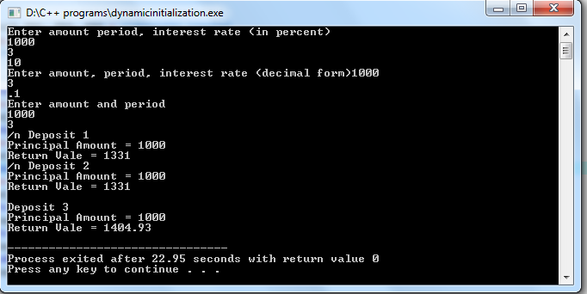
Output

Slide 32
DYNAMIC CONSTRUCTORS .. . Continued..
The constructors can be used to allocate memory while creating objects. This will enable the system to allocate the right amount of memory for each objects when the objects are not of the same size, thus resulting in the saving of memory.
Allocation of memory to objects at the time of their construction is known as dynamic construction of objects. The memory can be allocated with the help of the new operator.
Program below shows the use of new in constructors that are used to construct strings in objects.

Slide 33
Eg: to do string creation dynamically
#include <iostream>
#include <cstring>
using namespace std;
class String
{
char *name;
int length;
public:
String() //constructor " 1
{
length = 0;
name = new char[length + 1]; //one extra for \0
}
String (char * s) //constructor 2
{
length = strlen (s);
name = new char[length + 1];//one extra for \0
strcpy (name , s);
}
void display (void)
{
cout << name << " \n" ;
}
void join(String &a, String &b){
length = a. length + b. length;
delete name ;
name = new char [length + 1]; //dynamic allocation.
strcpy (name, a.name);
strcat (name, b. name);
}
};

Slide 34
Continued….
main ( )
{
char *first = " Joe " ;
String name1(first);
String name2(" Jim "), name3(" John "), s1, s2;
s1. join (name1, name2);
s2. join (s1, name3);
cout <<" .............\n";
name1. display ( ) ;
name2. display ( );
name3. display ( );
cout<<" After join function call \n";
cout<<"s1 = ";
s1. display ( );
cout<<"s2 = ";
s2 .display ( );
}

Slide 35
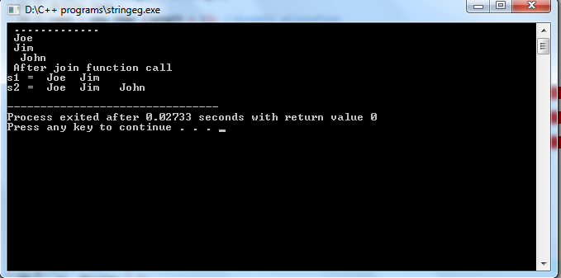
In the above program, we can see that, the memory allocated for the data member ‘name’
always depends on the size of the string the user wants to have.
That feature makes this program dynamic, whereby memory is allocated without any wastage.

Slide 37
Exception handling
Programs normally have bugs when they are done for the first time.
These bugs come under the category logical errors and syntactical errors.
These errors can be detected by means of proper debugging and testing procedures.
Some peculiar problems other than logical and syntactical errors are known as exceptions.

Slide 38
Exception handling (Continued..)
Exceptions are run time anomalies or unusual conditions that a program may encounter while executing.
Eg: - Division by zero , access to an array outside of its bounds , running out of memory space etc.
When a program encounters an exceptional condition, it is important to identify it and handle it in effective way.
C++ exception handling provides a safe , integrated approach to deal with unusual problems that arise while executing a program.
The purpose of exception handling mechanism is to provide means to detect and report an “exceptional circumstance” so that appropriate action can be taken.

Slide 39
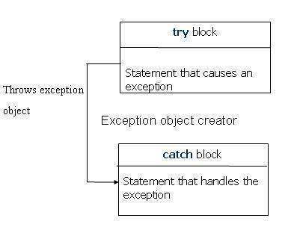
Exception handling
Exception handling mechanism suggests a separate error handling code that performs the following tasks.
1. Find the problem(hit the exception).
2. Inform that an error has occurred(Throw the exception)
3.Receive the error information.(Catch the exception)
4.Take corrective action.(Handle the exception)

Slide 40
.. Continued..
Exceptions provide a way to transfer control from one part of a program to another.
C++ exception handling is built upon three keywords: try, catch, and throw.
try: A try block identifies a block of code for which particular exceptions will be activated. It's followed by one or more catch blocks.
throw: A program throws an exception when a problem shows up. This is done using a throw keyword.
catch: A program catches an exception with an exception handler at the place in a program where you want to handle the problem.
Assuming a block will raise an exception, a method catches an exception using a combination of the try and catch keywords. A try/catch block is placed around the code that might generate an exception.

Slide 41
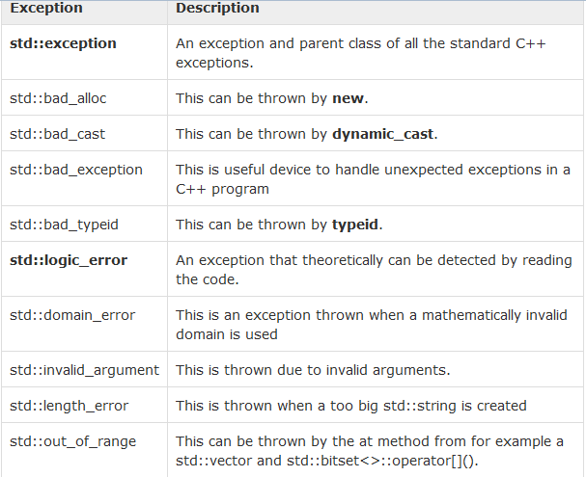
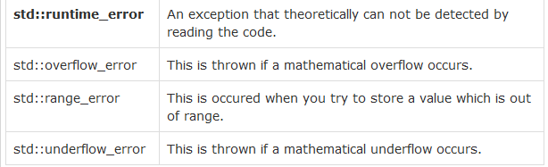
Types of exceptions

Slide 42
Exception handling
The catch block that catches an exception must immediately follow the try block that throws the exception. The general form of these two block is as follows:
try
{
------- throw exception;
-------
} catch(exception-type object)
{
- ------
-------
}
When a try block throws an exception, the program control leaves the try block and enters the statement of the catch block.
Exceptions are objects used to transmit information about a problem. If the type of object thrown matches the argument- type in the catch statement, then catch block is executed for handling the exception.

Slide 43
Eg: 1
int main()
{
int a,b,c;
float d;
cout<<"Enter the value of a:";
cin>>a;
cout<<"Enter the value of b:";
cin>>b;
cout<<"Enter the value of c:";
cin>>c;
try
{
if((a-b)!=0)
{
d=c/(a-b);
cout<<"Result is:"<<d;
}
The above program detects and catches a division-by-zero error. Different values of a and b will show how the exception mechanism works.
else
{
throw(a-b);
}
}
catch(int i)
{
cout<<"Answer is infinite because a-b is:"<<i;
} }

Slide 44
#include<iostream>
using namespace std;
void divide(int x,int y){
cout<<"inside the function\n";
if (y!=0)
{
float R =(float)x/y;
cout <<"result = "<<R;
}
else throw(y);
}
int main()
{
try{
cout<<"inside try\n";
divide(5,4);
divide(4,0);
}catch(int i)
{
cout<<"caught exception\n";
}
return 0;
}
Example 2: Invoking a function that generates an exception

Slide 45
Exceptions are normally thrown by functions that are invoked from within the try block . The point at which the throw is executed is called the throw point. Once an exception is thrown to the catch block , control cannot return to the throw point.
Throw point
Try block
Catch point

Slide 46
#include <iostream>
using namespace std;
int main()
{
int x = -1;
cout << "Before try \n";
try {
cout << "Inside try \n";
if (x < 0)
{
throw x;
cout << "After throw (Never executed) \n";
}
}
catch (int x ) {
cout << "Exception Caught \n";
}
cout << "After catch (Will be executed) \n";
return 0;
}
A program just to indicate the control flow in case of exceptions

Slide 47
Throwing mechanism
When an exception is detected, it is thrown using the throw statement
a. throw (exception);
b. throw exception;
c. throw ; // used for re-throwing
The object exception can be of any type, including constants.
When an exception is thrown , it will be caught by catch block associated with that try. Control exits the try block and enters catch block.

Slide 48
Catching mechanism
Catch block looks like a function definition and is of the form
catch(type argument)
{
// statements for handling exceptions
}
Type indicates the type of exception that catch block handles.
After executing the handler, control goes to the statements immediately following the catch block.
Due to mismatch, if an exception is not caught, then abnormal program termination occurs

Slide 49
Multiple catch statements
It is possible for a program segment to have more than one condition to throw an exception. In such cases, we can associate multiple catch statement with a try block.
try
{
//try block code
………..
}catch(type1 arg) { …. }
catch(type2 arg) {…}
….
catch (typeN arg){ … }
When an exception is thrown, the exception handlers are searched in order for an appropriate match. The first handler that yields a match is executed.

Slide 50
Eg:- for multiple catch blocks
void test(int x)
{
try{
if(x==1)throw x;
else if (x==0) throw 'x';
else if (x==-1) throw 1.0;
cout<<"end of try block\n";
}
catch (char c)
{
cout<<"caught a character\n";
}
catch (int c)
{ cout<<"caught an integer\n";
}
catch (double c)
{
cout<<"caught a double\n";
}
}
int main()
{
test(1);
test(0);
test(-1);
test(7);
return 0;
}

Slide 51
Catching all exceptions
Some times , we can force a catch block to catch all exceptions instead of a certain type alone.
This is achieved by defining the catch statement as follows
catch(…)
{
\\ statements
\\
}

Slide 52
Eg:- Catching all exceptions
void test(int x)
{
try{
if(x==1)throw x;
else if (x==0) throw 'x';
else if (x==-1) throw 1.0;
cout<<"end of try block\n";
}
catch (...)
{
cout<<"Caught an exception\n";
}
}
int main()
{
test(1);
test(0);
test(-1);
test(7);
return 0;
}

Slide 53
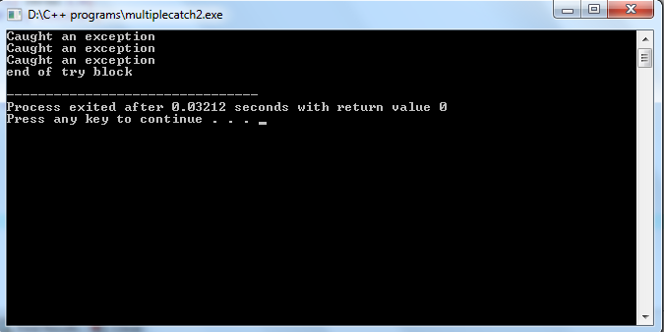

Slide 54
Re-throwing an Exception
A handler may decide to re-throw an exception caught without processing it. In such situations, we may simply invoke throw without any arguments.
throw;
This causes the current exception to be thrown to the next enclosing try/catch sequence and is caught by a catch statement listed after that enclosing try block.

Slide 55
Eg: - for re-throwing exceptions
void divide(double x, double y)
{
cout<<"Inside function \n";
try
{
if(y == 0.0)
throw y;
else
cout<<"Division = "<<x/y<<"\n";
}
catch(double)
{
cout<<"Caught double inside function \n";
throw;
}
cout<<" END OF FUNCTION \n";
}
main()
{
cout<<"Inside main \n";
try
{
divide(10.5,2.0);
divide(20.5,0.0);
}
catch(double)
{
cout<<"Caught double inside main \n";
}
cout<<"End of main";
}

Slide 56
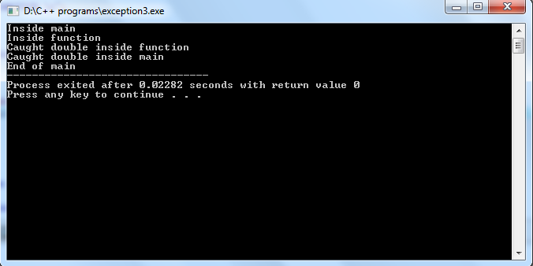

Slide 57
Specifying exceptions
It is possible to restrict a function to throw only certain specified exceptions.
It is done by adding a throw list clause to the function definition.
the general form is
type function-name(arg-list) throw (type list)
{…….
……….
}
Type-list specifies the type of exception that may be thrown.
Throwing any other type of exception will cause abnormal program termination.

Slide 58
.. Contd..
If we wish to prevent a function from throwing any type of exception, we may do so by making the type-list empty.
ie
returntype fnname (arg) throw()
{
}
This restriction applies only when throwing an exception out of the function and not within the function.

Slide 59
Eg: - for specifying exceptions
void test(int x) throw(int,double)
{
if(x==0) throw 'x';
else if (x==1)throw x;
else if (x==-1) throw 1.0;
cout<<" End of function block\n";
}
int main()
{
try{
cout<<"testing throw restrictions\n";
cout<<"x==0\n";
test(0);
cout<<"x==1\n";
test(1);
cout<<"x==-1";
test(-1);
cout<<"x==2\n";
test(2);
}catch(char c)
{
cout<<" caught a character\n";
}catch(int m)
{
cout<<" caught an integer\n";
}
catch(double m)
{
cout<<" caught a double\n";
}
cout<<"end of try catch system";
}

Slide 60
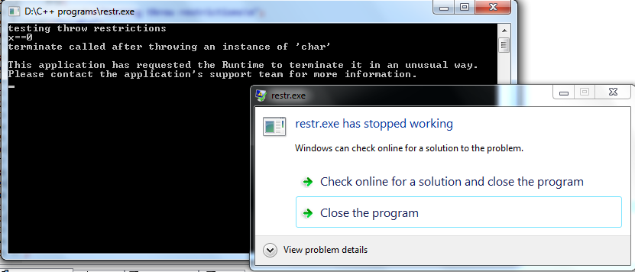
Output of previous pgm
If we donot “specify exceptions” in the function header, then also the program gets exception
in the first function call itself and terminates. In that case , it’s a successful termination of the program , giving a value back to compiler. But in this case, it’s an unsuccessful termination.

Slide 61
Namespaces
-- Used for defining scope.
For example, you might be writing some code that has a function called xyz() and there is another library available which is also having same function xyz(). Now the compiler has no way of knowing which version of xyz() function you are referring to within your code.
Namespaces are used in the C++ programming language to create a separate region for a group of variables, functions and classes etc.
Using namespace, you can define the context in which names are defined.

Slide 62
The following will list the primary reasons due to which a conflict can occur:
Between User defined variables/functions/classes and built in Library variables/functions/classes (e.g. sqrt(), abs() etc.)
Between the separately included library and built in library.
Between the variables/functions/classes of the one separately included library and the same of the other separately included library

Slide 63
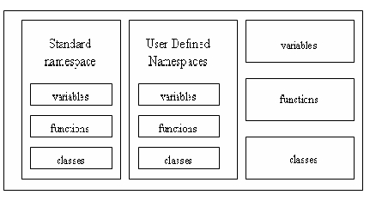
It puts the names of its members in a distinct space so that they don't conflict with the names in other namespaces or global namespace.

Slide 64
The directive,
using namespace std;
Specifies that the members defined in std namespace will be used throughout the program

Slide 65
Defining a namespace
namespace namespace_name
{
// declarations of variable, functions and classes
//
}

Slide 66
namespace Testspace
{
int m;
void display(int n)
{cout<<n;
}
}
To assign values to m , we can use
Testspace::m =10;
…………………………………………………..
Using namespace Testspace ; // using directive
m=100; //OK
display(100); //OK
……………………………….
Using testspace::m; // using declaration
m =100; //OK
display(100); // Cannot access

Slide 67
Rules to create Namespace
The namespace definition must be done at global scope, or nested inside another namespace.
Namespace definition doesn't terminates with a semicolon like in class definition.
You can use an alias name for your namespace name, for ease of use.
You cannot create instance of namespace.
There can be unnamed namespaces too.

Slide 68
Nesting of namespaces
A namespace can be nested within another namespace.
Eg:-
namespace ns1{
………..
………..
namespace ns2 {
int m =10;
}
………..
………
}
to access m, we must quality the variable with both the enclosing namespace names.
Ie,
cout<<ns1::ns2::m;
or using namespace ns1;
cout<<ns2::m;

Slide 69
Unnamed namespaces
Unnamed namespace is one which doesn’t have a name.
They occupy global scope and are accessible in all scopes following the declarations in the file.
They are accessible without any qualification.

Slide 70
A sample program
#include <iostream>
using namespace std;
namespace name1
{
double x = 4.56;
int m =100;
namespace name2
{
double y = 1.23;
}
}
namespace {
int m = 200;
}
int main()
{
cout<<"x = "<<name1::x<<"\n";
cout<<"m = "<<name1::m<<"\n";
cout<<"y = "<<name1::name2::y<<"\n";
cout<<"m = "<<m;
return 0;
}

Slide 71
Eg:- for using functions in namespace scope
#include<iostream>
using namespace std;
namespace func
{
int divide(int x,int y)
{ return (x/y);
}
int product(int x,int y);
}
int func::product(int x, int y)
{
return (x * y);
}
int main()
{
using namespace func;
cout<<"division result= "<<divide(20,10);
cout<<"product = "<<product(10,5);
return 0;
}

Slide 72
Use of classes in namespace
#include<iostream>
using namespace std;
namespace classes
{
class Test
{
int m;
public:Test(int a)
{
m=a;
}
void display()
{
cout<<"m = "<<m;
}
};
}
int main()
{
classes::Test t1(100); // using scope resolution
t1.display();
using namespace classes; // using directive
Test t2(50);
t2.display();
return 0;
}

Slide 73
Remaining slides contain some extra notes related to module 4.

Slide 74
call by reference
The call by reference method of passing arguments to a function copies the reference of an argument into the formal parameter. Inside the function, the reference is used to access the actual argument used in the call. This means that changes made to the formal parameter affect the actual argument.
This method is not available with C language.
Eg: - void swap(int &x, int &y)
{
int temp;
temp = x; /* save the value at address x */
x = y; /* put y into x */
y = temp; /* put x into y */
return;
}

Slide 75
#include <iostream>
using namespace std;
void swap(int &x, int &y);
int main ()
{
// local variable declaration:
int a = 100;
int b = 200;
cout << "Before swap, value of a :" << a << endl;
cout << "Before swap, value of b :" << b << endl; /* calling a function to swap the values using variable reference.*/
swap(a, b);
cout << "After swap, value of a :" << a << endl;
cout << "After swap, value of b :" << b << endl;
return 0;
}

Slide 76
An example of using classes and exceptions:- on stack
int main()
{
stack s1;
try{
s1.push(11);
s1.push(22);
s1.push(33);
// s1.push(44);
cout<<"poping out";
cout<<s1.pop();
cout<<s1.pop();
cout<<s1.pop();
// cout<<s1.pop();
}catch(stack::range)
{ cout<<"Exception \n";
}
return 0;
}
#define MAX 3
class stack
{
private:int st[MAX];
int top;
public:
class range{
};
stack(){
top = -1;
}
void push(int var)
{ if (top>=MAX) throw range();
st[++top] = var;
}
int pop()
{
if (top<0)
throw range();
return st[top--];
} };

Slide 77
Namespaces and Using Directives
We have already been using the namespace that is named std. The std namespace contains all the names defined in many of the standard C++ library files (such as iostream). For example, when you place the following at the start of a file
#include <iostream> that places all the name definitions (for names like cin and cout) into the std namespace. Your program does not know about names in the std namespace unless you specify that it is using the std namespace. To make all the definitions in the std namespace available to your code, you insert the following using directive:
using namespace std; A good way to see why you might want to include this using directive is to think about why you might want to not include it. If you do not include this using directive for the namespace std, then you can define cin and cout to have some meaning other than their standard meaning. (Perhaps you want to redefine cin and cout because you want them to behave a bit differently from the standard versions.) Their standard meaning is in the std namespace, and without the using directive (or something like it), your code knows nothing about the std namespace, and so, as far as your code is concerned, the only definitions of cin and cout are whatever definition you give them.

